Slide 1
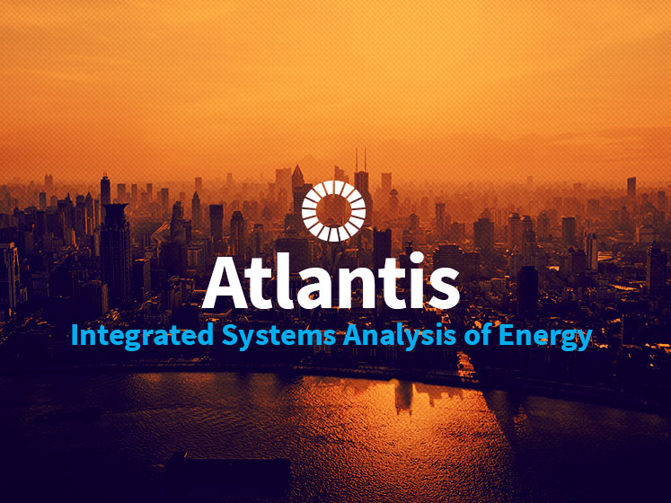
OSeMOSYS

Slide 2
Outline
Energy and electricity systems modelling
Electricity systems modelling
Introduction to electricity modelling in OSeMOSYS

Slide 3
1. Energy and electricity systems modelling Objective: Review the link between development and energy, including electricity infrastructure, and understand the basics of energy mid- and long-term planning.

Slide 4
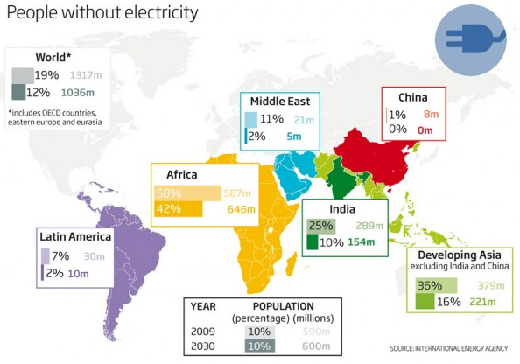
Access to energy: a major development concern
In 50 developing countries, more than one-third of the population does not have access to electricity. This amounts to 1.2 billion people worldwide.
The demand for electricity in developing countries is expected to triple before 2030.
Businesses in 30 developing countries have reported more than five power outages in a typical month.
World Energy Outlook 2012, International Energy Agency, Paris
Notes:
Access to electricity is a critical development challenge in sub-Saharan Africa. Only 290 million out of 915 million people have access to electricity, and the total number without access is rising because the region has the fastest population growth rate.
These numbers might slightly change in different sources.
Source: https://makewealthhistory.files.wordpress.com/2012/10/people-without-electricity.jpg.

Slide 5

Energy and the 2030 Agenda for Sustainable Development
Medium- to long-term planning can produce insights that can inform policies related to the SDGs.
Notes:
Globally, a number of initiatives are trying to address energy in a sustainable manner. One is the 2030 Agenda for Sustainable Development, launched in September 2015 by the United Nations. Its 17 SDGs balance the three dimensions of sustainability: society, the economy and the environment. The seventh SDG envisions global access to affordable, reliable, sustainable and modern energy services by 2030.

Slide 6
Energy and the 2030 Agenda for Sustainable Development
Illustrative linkages
Notes:
Energy system medium- to long-term modelling can produce insights to inform policies related to SDGs on good health and well-being; affordable and clean energy; gender equality; industry, innovation and infrastructure; and climate change.
For instance, on SDG 3 on health, energy is currently a major source of air pollution (both indoor and outdoor). Flue gases produced by the incomplete combustion of solid fuels cause about 4.3 million deaths per year, especially among women and children (WHO, 2014). Having fewer women and girls collecting firewood for cooking and heating would be a gender equality intervention related to SDG 5. SDG 9 is directly influenced by energy. Reliable and affordable energy infrastructure can be the engine for economic growth and emerging industries, such as renewable energy sources.

Slide 7
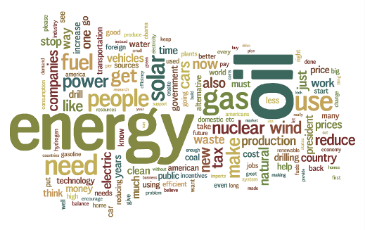
Energy policy
Energy policy is the manner in which a given entity (often governmental) has decided to address energy development, including supply, distribution and end uses.
It includes, among others:
Energy security
Environmental protection
Market structures
Incentives or disincentives (e.g., feed-in tariffs, carbon taxes)
Directives (e.g., measures for efficiency improvements).
Notes:
Energy policy also affects energy infrastructure related to resource extraction and imports, conversion, transmission and distribution, and the provision of energy services (including end-use infrastructure such as buildings, plants, equipment, devices, etc.).
Meeting energy demand is of course the main objective of energy policies, but not the only one. As we can see, introducing renewables, increasing energy efficiency, enhancing energy security and other issues are gaining more attention in energy policies. That challenges policy makers to account for all of these issues.

Slide 8
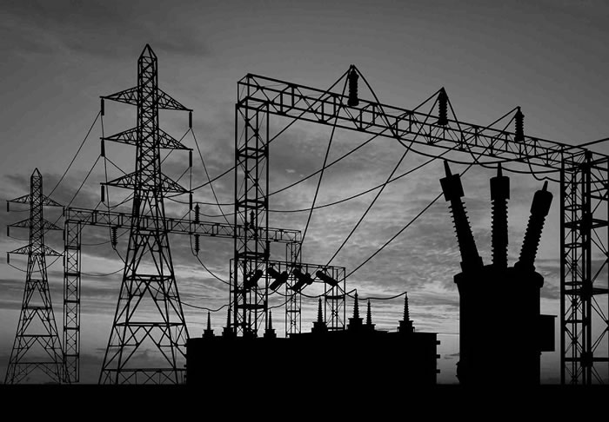
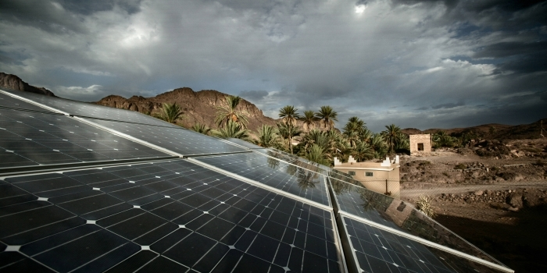
Policy questions
What would be the impact of large swings in oil prices?
Can we fully rely on renewables?
If not, what is the maximum share of renewables that the energy system can accommodate? Can it be financed?
Should the tax on transport fuels increase to encourage public transportation?
Would switching to "advanced technologies" allow us to continue improving living standards and simultaneously avoid climate change?
Can we really afford heavy upfront investment technologies? For example, wind, concentrated solar power, photovoltaic, hydro, etc.?
What is the impact of energy efficiency measures on the supply mix?

Slide 9
What is energy modelling?
Energy modelling provides insights NOT answers
Energy modeling creates simplified images of real-life energy systems by translating the components, structures and flows into tractable mathematical formulations (equations).
The equations represent rule-based interactions between the key system components.
Once calibrated to reflect the current energy system and base year energy flows, future technology and fuel options (portfolio) as well as demand projections need to be added.
Scenarios provide a look forward.
Different agents require different answers and thus different models or model details (no one size fits all).
Energy modelling is an art not a science.
The information models provide is often complex and needs to be “interpreted/conditioned” for use by decision makers or market agents.
Notes:
Insights not answers: In many cases, big uncertainties in the inputs mean even bigger uncertainties in the outputs. So what is the role of energy modelling? It deals with and sheds light on “what if” questions. Simulating a number of scenarios with a certain model can help illuminate factors expected to have a big influence on the future energy mix – or not. If yes, more detailed analysis can consider their influence.
Important: The use of scenarios indicates that NO FORECASTING is made, but just “what if” analyses.
Art not a science: The boundary between what is included in the analysis at which level of detail depends on the task at hand and has to be determined by the modeller.

Slide 10
Architecture of the energy system
What
nature
provides
Sources
oal oil natural gas sunlight uranium wind biomass
Extraction
treatment
coal hydro oil cleaning separation benefication liquef- gasifi-
mine dam rig action cation
Conversion
technologies
hydro thermal power oil nuclear generating photovoltaic wind
station plant refinery station cell converter
Energy
sector
Energy flows
“fuels”
electricity
gasoline
methanol
methane
hydrogen
heat
Distribution
electricity grid
gas grid
truck
dewar
railway
district heat grid
Service
technologies
automobile
light
bulb
telephone
furnace
microwave
oven
aircraft
PC
Infrastructure
transportation
communication
keeping warm/cold
food
What
people
want
Services
potable water
health care
security
consumer goods
Notes:
This takes the engineer’s angle to energy (not the angle of the economist or physicist). The focus is energy services.
This figure presents numerous energy chains that connect energy sources to energy services. Technologies (rectangles in the figure) provide the necessary links by converting fuels or renewable energy flows into the energy services modern societies demand.
The energy system is driven by the quantity and quality of the demand for energy services.
Each rectangle is characterized by capacity, investment costs, fuel inputs (e.g., oil or sunlight), conversion efficiency, outputs (e.g., diesel, electricity), operating costs, emissions of pollutants and further techno-economic parameters. Technologies, not energy source per se, define the long-term sustainability of the energy system. So, they are the ones subject to policies.
* Explain how we go from energy sources to energy services as shown in the figure.

Slide 11
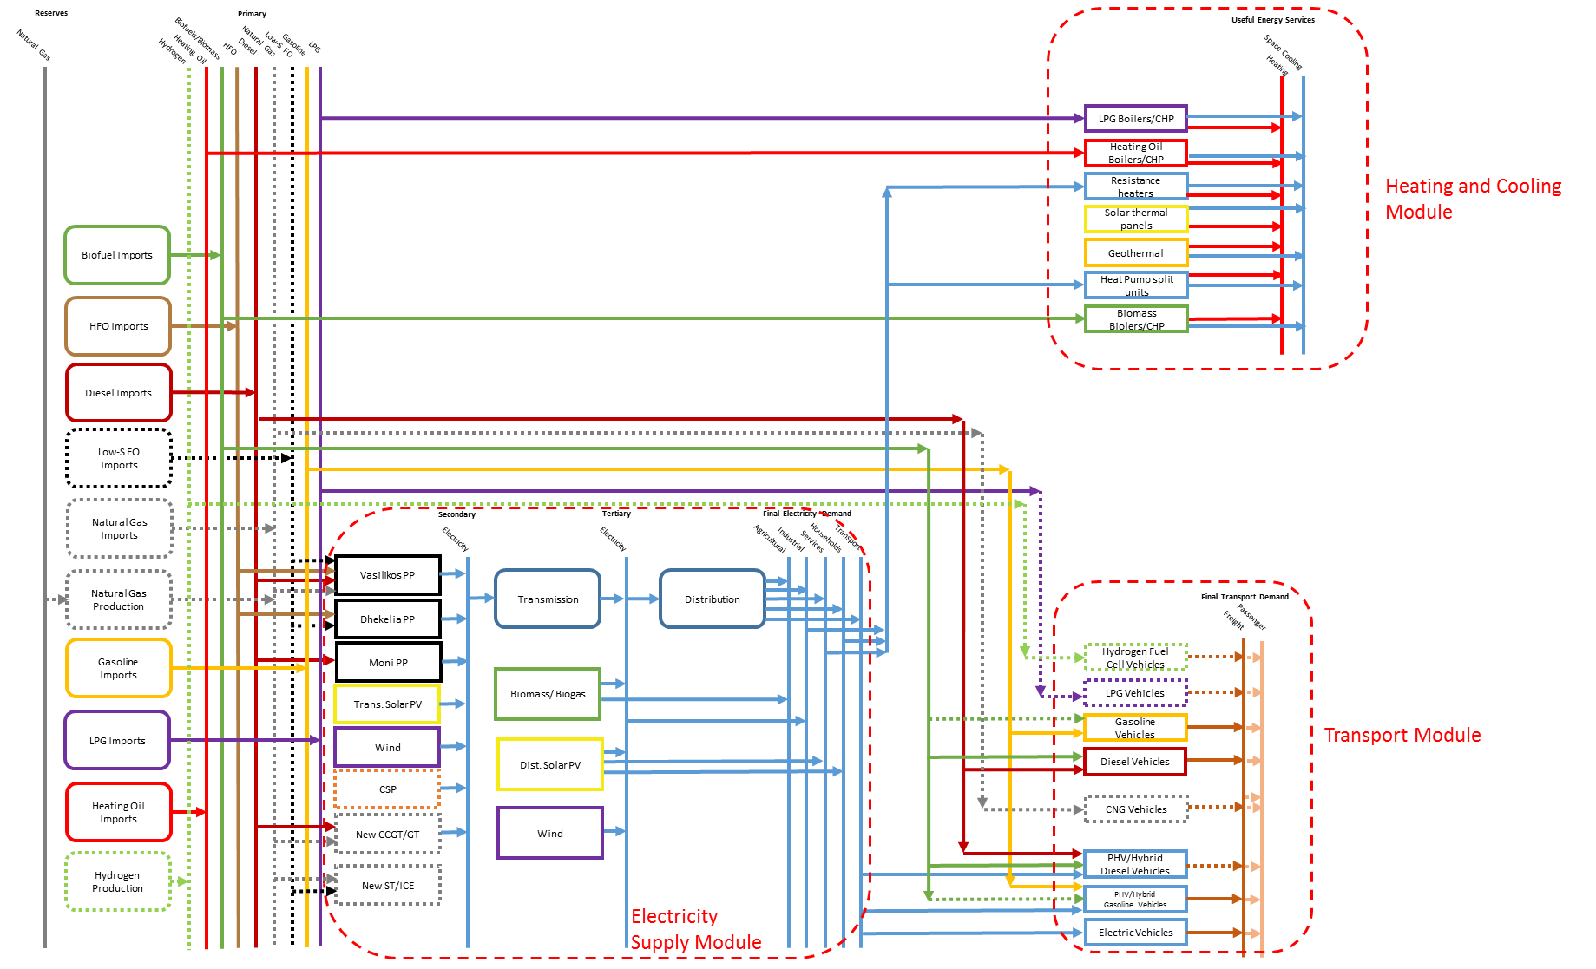
Reference energy system
Notes:
There are ways to map out all possibilities for linking resources to final uses. A very effective one, often used in energy systems modelling, is the so-called reference energy system. This is a black-box schematic representation of the real electricity system of the country/region that is being modelled.
It shows existing plants and flows as well as a portfolio of future options. The flow of energy is represented horizontally from resources on the far left, going through different transformation technologies, to reach final energy use on the far right. The figure shows a reference electricity system for Cyprus.
With this structure displaying all possible links, we now have to compute which technologies will actually be installed among those available, and how much they will contribute to meeting electricity demand.

Slide 12
Exercise 1
1) Draw a simple aggregate reference energy system of your country including:
Up to 10 main technologies or groups of technologies
Up to 3 demand types (e.g., electricity, heating, transportation)
Transmission and distribution technology
Distinction between imported and domestically produced primary resources
2) Describe the main features in a short narrative to be presented during group discussions.

Slide 13
Exercise 1
1) Example of a reference energy system

Slide 14
Exercise 1
2) Example of narrative
The electricity supply relies mostly on natural gas combined cycles, on large hydropower plants and wind farms. Natural gas is imported. Rooftop photovoltaic installations are increasing in the residential sector. Heating demand is met mainly through electric or natural gas-fuelled boilers, while the main fuel for transportation is diesel.

Slide 15
Why energy modelling?
The energy system is a “complex system.” Energy planning needs at least to account for:
The longevity of power plants and energy infrastructure
Existing technology portfolios and future technology options
Costs, variability of demand, technology limitations, among others
The necessity of meeting the demand in an efficient and sustainable way
The most important items of the system with a quantification of their inter-relationships
Models allow us to:
Sharpen the focus of the analysis and define the boundaries
Quantify the assumptions and make them visible
Repeat studies under different assumptions
Modelling is a communication tool and can be powerful in informing debates.
Notes:
Energy policies have inherently long-term effects, given the long life of infrastructure (up to 50 years or more) and power plants, and given that policies have to consider the whole life cycle of these (from commissioning to decommissioning). Investments made today may cause lock-ins and/or stranded investments, and have a great impact on the shape of the energy future and people’s lives. It is critical to get policies right and based on forward-looking analytical tools.

